Slide 1
Health Insurance Premium Prediction
Team [no.]
Documentation lead
Gajjela Sri Charan · sricharan-iitrpr
Execution lead
Harshit Agrawal · HarshitAgrawal-2030
Predicting a person’s insurance charges from age, BMI, smoking status and other details with linear regression
PPT lead
Harshit Bansal · HarshitBansal-2008
Video lead
Aryan Hemant Sawant · aryan-s-iitrpr
Repository
github.com/HarshitAgrawal-2030/InsurancePriceML
AI101: Data Science and AI Essentials with Python
School of AI and Data Engineering, IIT Ropar
Notes:
Introduce the team and say who leads each deliverable.

Slide 2
Can personal details predict a health insurance premium?
What and why
Column | Meaning
age | Age of the person
sex | male / female
bmi | Body Mass Index
children | Children covered by the insurance
smoker | yes / no
region | northeast, northwest, southeast, southwest
charges (target) | Insurance cost billed, used as the premium
Build a model that estimates a person’s premium from six personal details
Charges vary from about 1,100 to 63,800, so a single average says little
A simple, explainable baseline shows which details move the cost
Dataset source
insurance.csv, the Medical Cost Personal dataset on Kaggle
1,338
7
0
rows, 1,337 after removing 1 duplicate
columns: 6 inputs and 1 target
missing values
Notes:
State the problem, then the dataset size and the target column.

Slide 3
From a raw CSV to premium predictions in six steps
DATA
MODEL
OUTPUT
1
Load
2
Clean
3
Encode
4
Split
5
Train
6
Evaluate
insurance.csv
1,338 rows, 7 columns
Check missing values, drop 1 duplicate
One-hot encode sex, smoker, region: 8 features
80% train (1,069)
20% test (268)
Linear regression fits one coefficient per feature
MAE, MSE, RMSE, R² and prediction plots
Libraries used
pandas
NumPy
Matplotlib
seaborn
scikit-learn
Load and clean tables
Numerical work
Plots
Heatmap, residuals
Split, model, metrics
Notes:
Walk the pipeline left to right: data, model, output.

Slide 4
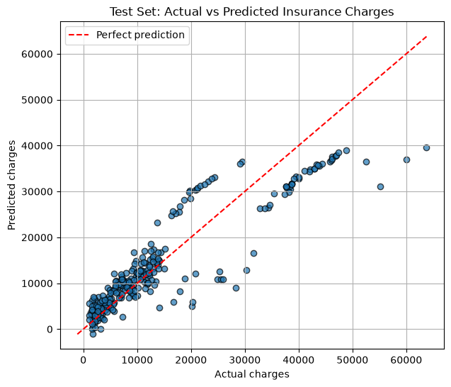
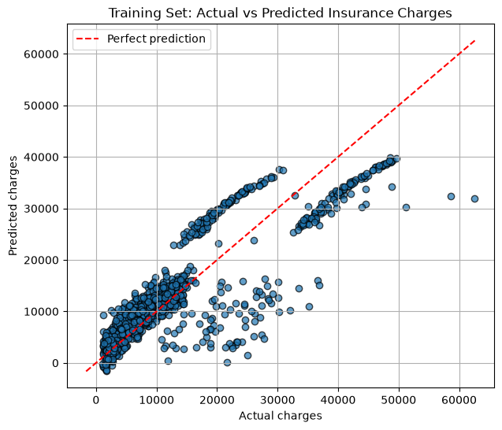
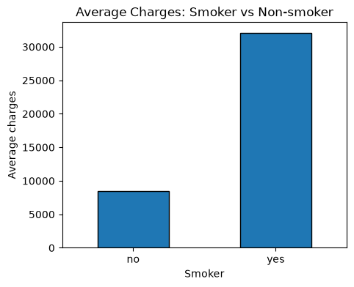
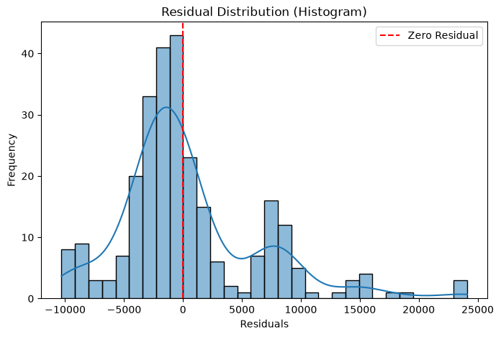
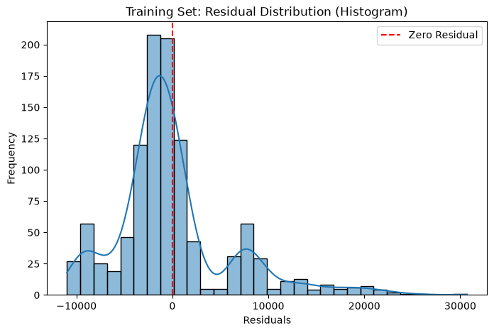
The model explains 81% of test variation but misses high costs
Metric | Train | Test
MAE | 4,181.90 | 4,177.05
MSE | 36,979,860.90 | 35,478,020.68
RMSE | 6,081.11 | 5,956.34
R² | 0.730 | 0.807
Sample test predictions
Test: tracks actuals, short above 50,000
Train: same pattern as the test set
Smokers pay about 4× more on average
Actual | Predicted | Error
8,689 | 8,144 | +545
5,709 | 5,737 | −28
38,746 | 31,746 | +7,001
38,512 | 30,447 | +8,065
Demo: age 30, male, BMI 27.5,
1 child, non-smoker, southeast
Predicted premium: 4,710.51
Test residuals: second peak near +8,000
Train residuals: same second peak, a consistent gap
Notes:
Lead with test R-squared, then the average error. Point to the two high-cost sample rows and the second residual peak, then show the demo prediction.

Slide 5




What worked, what didn’t, and who did what
What worked
What didn’t
Clean data: no missing values, one duplicate
Test R² of 0.807 from a simple baseline
Train and test MAE almost equal (4,182 vs 4,177), so no sign of overfitting
Bar chart exposed smoking as the main cost signal
Average error is about 31% of the mean charge
Residuals show a second peak near +8,000: a group is underpredicted
Test R² above train R² suggests a favourable single split; cross-validation would confirm
Who did what
AI-use disclosure
Documentation lead: Gajjela Sri Charan, README review and code
Claude: built these slides from our notebook and the course briefing; wrote the first README draft, later reviewed and edited by Sri Charan.
ARGON(LOW): suggested different evaluation models.
GPT: helped find bugs and write parts of the code more efficiently.
No AI was used to generate the dataset or the results.
Execution lead: Harshit Agrawal, execution and code
PPT lead: Harshit Bansal, presentation and code
Video lead: Aryan Hemanth Sawant, video and code
Notes:
Be honest about the limits, say who did what, and disclose AI use.

